Slide 1
INVENTORY MANAGEMENT

Slide 2
INVENTORY
  An inventory is a stock or store of goods.
    The amounts and dollar values of inventories carried by different types of firms vary widely. A typical firm probably has 30% of its current asset and 90% of its working capital invested in inventory.
  Different kinds of inventories -
  Raw materials and purchased parts (Clay used in tiles production firms)
  Work in Progress - WIP (Tiles under production)
  Finished goods inventories (Ready tiles)
  Replacement parts, tools and supplies (Replacing defective tiles)
  Goods in transit to warehouses or customers - Pipeline inventory
  (Tiles for sale)

Slide 3
FUNCTIONS OF INVENTORY (WHY WE NEED IT …)
  To meet anticipated customer demand - A customer can be a person who walks in off the street to buy a new product (Rangs Showrooms)
  To smooth production requirements – Firms that experience seasonal patterns in demand often build up inventories during pre-season periods to meet overly high requirements during seasonal periods (IGLOO and other ice cream companies)
  To decouple operations – Manufacturing firms keep buffer stock to tackle any disruption in the operation. The buffers permit other operations to continue temporarily while the problem is resolved (Cement factories)
  To protect against stockout – Unexpected increases in demand increase the risk of shortages. Delays can occur because of weather condition, delayed deliveries, quality problem etc. The risk of shortage can be reduced by holding safety stock.

Slide 4
FUNCTIONS OF INVENTORY (CONTD.)
  To take advantage of order cycles – To minimize purchasing cost, firms often buy more than current requirement. They use this additional quantity for later production. This enables the firms to buy or produce in economic lot sizes without trying to match purchases or production with demand requirements in the short run. This results in order cycle
  To hedge against price increase – When firms sense any possibility of price increase they purchase larger than normal amounts to beat the increase. The ability to store extra goods allow the firms to take the advantage of discount for larger orders (Agreement between DIPON and Paradise Cables to supply cable for Haripur Compressor Station work)
  To permit operations – Inventory of raw material, semi-finished goods and finished goods as well as goods stored in warehouses allow the operation to continue at different stages.
  To take advantage of quantity discount – Suppliers give discount on large orders.

Slide 5
INVENTORY COUNTING SYSTEM
  Periodic System – Under this system a physical count of the items in inventory is made at periodic intervals (e.g. – weekly, monthly) to determine how much to order.
    Many small retailers use this approach.
    An advantage of this system is that orders for many items occur at the same time and helps to save ordering and shipping cost.
    One of the major disadvantage is the shortages between review periods.
  Perpetual Inventory System – This system keeps track of removals from inventory on a continuous basis, so the system can provide information on the current level of inventory for each item.
    An obvious advantage is continuous monitoring of inventory withdrawals. Also helps to order optimum quantity.
    One disadvantage of this system is added cost of record keeping.

Slide 6

INVENTORY COUNTING SYSTEM (CONTD.)
  Universal Product Code or Bar Code – Universal product code or bar code printed on a label that has information about the item to which it is attached.
Identifies this product as a grocery item
0
Indicates the specific item
214800 232087768
Identifies the manufacturer

Slide 7
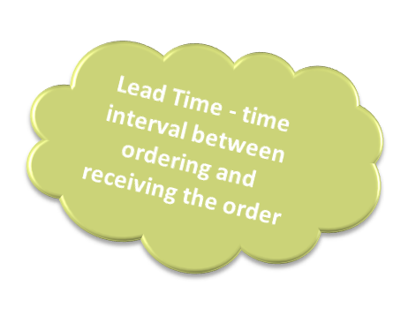
INVENTORY COSTS
  Three basic costs are associated with inventories –
  Holding or Carrying Cost – The cost to carry an item in inventory for a length of time.
    Holding or carrying cost is a variable cost. Costs include warehousing cost (heat, light, rent, security), insurance, spoilage, breakage cost etc.
    Typically annual holding costs range from 20% to 40% of the value of an item.
  Ordering Cost – Ordering costs are the costs of ordering and receiving inventory.
    Ordering cost is a fixed type cost. Costs include invoice cost, shipping cost, inspection cost etc.
  Shortage Cost – Costs resulting when demand exceeds the supply of inventory (Result – Not making a sale, loss of customer goodwill etc.).

Slide 8
ABC CLASSIFICATION SYSTEM
Classifying inventory according to some measure of importance (usually in annual dollar value) and allocating control efforts accordingly.
  A - Very important
  B - Moderately important
  C - Least important
High
A
Annual
$ value
of items
B
C
Low
Few
Many
Number of Items

Slide 9
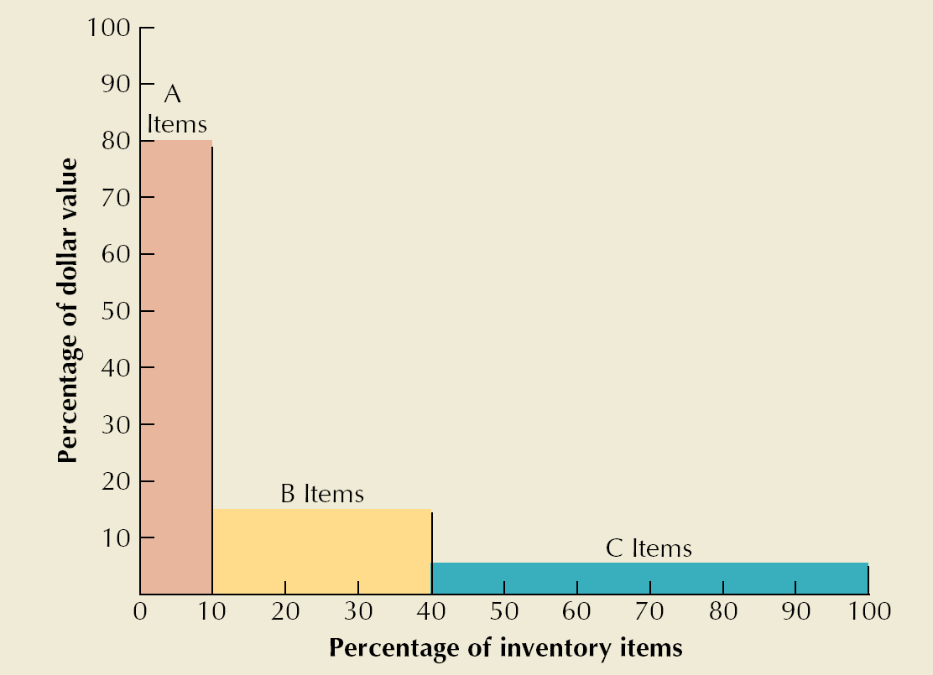
ABC Classification
Class A
  10 – 20 % of units
  60 – 80 % of value
Class B
  30 % of units
  15-25 % of value
Class C
  50 – 60 % of units
  5 – 10 % of value
12-<number>
Copyright 2006 John Wiley & Sons, Inc.

Slide 10
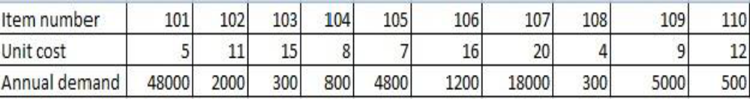
Example 1
The annual consumption value is calculated with the formula:
(Annual demand) * (item cost per unit)
Through this categorization, the supply manager can identify inventory hot spots, and separate them from the rest of the items, especially those that are numerous but not that profitable
2-<number>

Slide 11
Item no. | TC | % 0f dollar value | % of Items
107 | 360,000 A
101 | 240,000 A | (600000/737900)*100=81.3% | (2/10)*100=20%
109 | 45,000 B
105 | 33,000 B
102 | 22,000 B | (119200/7379000*100=16.15% | 40%
106 | 19,200 B
104 | 6,400 C
110 | 6,000 C
103 | 4,500 C | 2.45% | 40%
108 | 1,200 C
Total | 737,900
Step 1
Item number | Unit cost | Annual demand | Total cost per year
101 | $5 | 48,000 | $240,000
102 | 11 | 2,000 | 22,000
103 | 15 | 300 | 4,500
104 | 8 | 800 | 6,400
105 | 7 | 4,800 | 33,600
106 | 16 | 1,200 | 19,200
107 | 20 | 18,000 | 360,000
108 | 4 | 300 | 1,200
109 | 9 | 5,000 | 45,000
110 | 12 | 500 | 6,000
Total usage |  |  | 737,900
2-<number>
Total cost per year: Unit cost * Annual demand

Slide 12
Cathegory | Items | Percentage of items | Percentage usage (%)
Class A | 107, 101 | 20% | 81.3 %
Class B | 109, 105, 102, 106 | 40% | 16.2%
Class C | 104, 110, 103, 108 | 40% | 2.5%
A
Item
B item
2-<number>

Slide 13
ABC CLASSIFICATION SYSTEM – EXAMPLE 02
The manager of an automotive repair shop hopes to achieve a better allocation of inventory control efforts by adopting A-B-C approaches to inventory control. Given the monthly usage in the following table, classify the items in A, B, C categories according to dollar usage.

Slide 14
EXAMPLE 02 (CONTD.)
Item | Usage | Unit Cost | Total annual Value: Calculation | Classification
4021… | 75 | $10 | 75 x $10 = $750 | C
9403… | 5 | $510 | 5 x $510 = $2,550 | C
4066… | 40 | $70 | 40 x $70 = $2,800 | C
6500… | 1000 | $8 | 1000 x $8 = $8,000 | B
9280… | 200 | $10 | 200 x $10 = $2,000 | C
4050… | 3500 | $3 | 3500 x $3 = $10,500 | B
6850… | 25 | $700 | 25 x $700 = $17,500 | A
3010… | 150 | $6 | 150 x $6 = $900 | C
4400… | 20 | $350 | 20 x $350 = $7,000 | B
% Dollar
% item
17500 A (28000/52000)*100=53.85%, 22.22%
10500 A
B (15000/52000)*100=28.85%, 22.22%
7000 B
2800 C
2550 C
2000 C (8950/52000)*100=17.21%, 55.55%
900 C
750 C
Total=$52000

Slide 15

100
90
80
70
60
50
40
30
20
10
17500 A (28000/52000)*100=53.85%, 22.22%
10500 A
B (15000/52000)*100=28.85%, 22.22%
7000 B
2800 C
2550 C
2000 C (8950/52000)*100=17.21%, 55.55%
900 C
750 C
A
B
C
0 10 20 30 40 50 60 70 80 90 100
Percentage of items
2-<number>

Slide 16
EXAMPLE 03
The following table contains the monthly volume and unit costs for a random sample of sixteen items 2,000 inventory items at a health care facility. Develop A-B-C classification for these items.

Slide 17
EXAMPLE 03 (CONTD.)
Item | Usage | Unit Cost($) | Dollar Value | Classification | Item | Usage | Unit Cost($) | Dollar Value | Classification
K34 | 50 | 1200 |  |  | F99 | 20 | 1100
K35 | 20 | 400 |  |  | D45 | 40 | 100
K36 | 72 | 300 |  |  | D48 | 24 | 180
M10 | 160 | 400 |  |  | D52 | 60 | 80
M20 | 40 | 600 |  |  | D57 | 32 | 1000
Z45 | 60 | 1600 |  |  | N08 | 20 | 60
F14 | 40 | 160 |  |  | P05 | 80 | 240

Slide 18
INVENTORY CYCLE
Profile of Inventory Level Over Time
Q
Usage
rate
Quantity
on hand
Reorder
point
Time
Receive
order
Place
order
Receive
order
Place
order
Receive
order
Lead time

Slide 19
Reorder Point
Quantity to which inventory is allowed to drop before replenishment order is made
Need to order EOQ at the Reorder Point:
  ROP = d X LT
  d = Demand rate per period
  LT = lead time in periods

Slide 20
Reorder Point: Example
Demand = D= 10,000 yards/year
Store open 311 days/year
Daily demand =d= 10,000 / 311 = 32.154 yards/day
Lead time = LT = 10 days
ROP = dLT = (32.154)(10) = 321.54 yards
12-<number>
Copyright 2006 John Wiley & Sons, Inc.

Slide 21
Economic Order Quantity (EOQ) Models
EOQ
  optimal order quantity that will minimize total inventory costs
Basic EOQ model
Production quantity model
12-<number>

Slide 22
Assumptions of Basic EOQ Model
Demand is known with certainty and is constant over time
No shortages are allowed
Lead time for the receipt of orders is constant
Order quantity is received all at once
12-<number>
Copyright 2006 John Wiley & Sons, Inc.

Slide 23
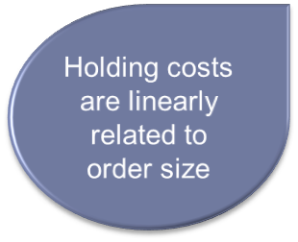
ECONOMIC ORDER QUANTITY (EOQ) MODEL
Q
H
Annual Holding Cost =
2
Where,
Q = Order quantity in units
H = Holding (or carrying) cost per unit
Annual Cost
Q
H
2
Order Quantity (Q)

Slide 24
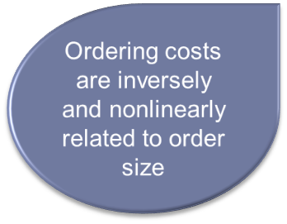
ECONOMIC ORDER QUANTITY (EOQ) MODEL (CONTD.)
D
S
Annual Ordering Cost =
Q
Where,
Q = Order quantity in units
D = Demand, in units per year
S = Ordering cost
Annual Cost
D
S
Q
Order Quantity (Q)

Slide 25
ECONOMIC ORDER QUANTITY (EOQ) MODEL (CONTD.)
Total cost =
Annual holding cost
Annual ordering cost
+
Q
D
TC =
H
+
S
2
Q
TC
Holding Costs
Annual Cost
Ordering Costs
Q_{O}
(optimal order quantity)
Order Quantity (Q)

Slide 26
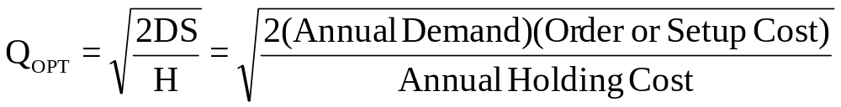
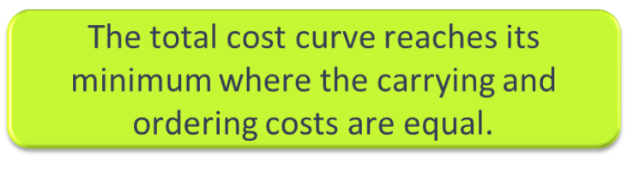
DERIVING THE EOQ
Q
D
TC =
H
+
S
2
Q

Slide 27
EOQ Example
H = $0.75 per yard S= $150 D = 10,000 yards
Operates 250 days per year
What is EOQ and Minimum Total cost
What is optimum number of orders per year
What is order cycle time
Calculate total cost of the inventory

Slide 28
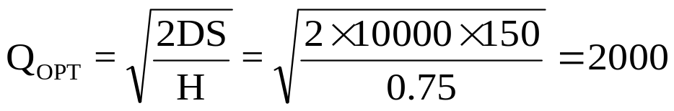
a.
Yards
b. No. of order cycle=D/Q= 10000/2000=5
c. Length of order cycle=Q/D=2000/10000=0.2 of a year= 0.2*250=50 days
d.
Annual holding cost
Annual ordering cost
Total cost =
+
Q
D
TC =
H
+
S
2
Q
= (2000/2)*0.75 + (10000/2000)*150= $1500
2-<number>

Slide 29


